Slide 1
Simple Plagiarism Detection Utility using String Matching
Malak Mekky (900222132), Youssef Bakir (900221920) & Omar Badawy (900212151)

Slide 2
01
Introduction
02
Class Structure
03
Algorithm
04
QT application
05
Conclusion

Slide 3
01 Introduction
A crucial component of academic integrity protection is plagiarism detection.
In order to find similarities between texts and spot plagiarism, string-matching algorithms are essential.
The algorithms we will explore are:
Brute force / hamming distance algorithm
The Knuth-Morris-Pratt (KMP) algorithm
Rabin Karp algorithm
Boyer Moore approach

Slide 4
02
Class Structure
x
y
UML notation

Slide 5
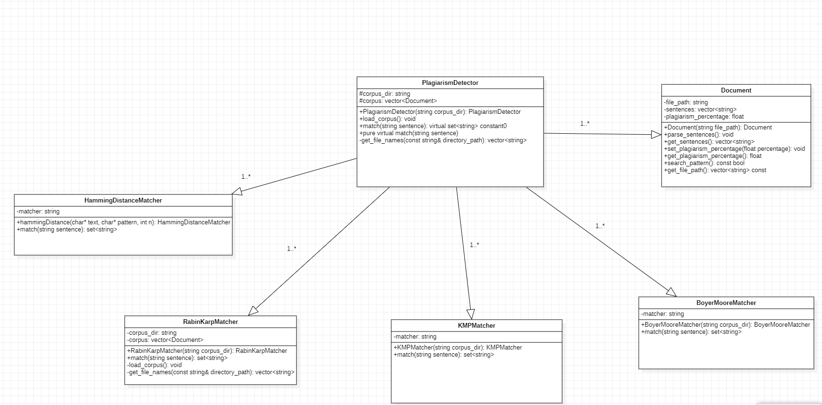

Slide 6
03
Algorithms
x
y

Slide 7
Brute force / hamming distance approach
Theory
Complexity
The complexity of this approach is O(n *m)
n the worst-case scenario, when the pattern either exists at the end of the text string or does not exist, the algorithm will perform n - m+1 comparisons.
This makes it highly inefficient for a large amount of text
Works by sequentially comparing a pattern to the text string to determine there is a match
It aligns the pattern string's first character with the text string's first character.
compares each character in the pattern to its matching character in the text.
if the characters do not match, the index of the pattern is shifted once to the right and then compared again.

Slide 8
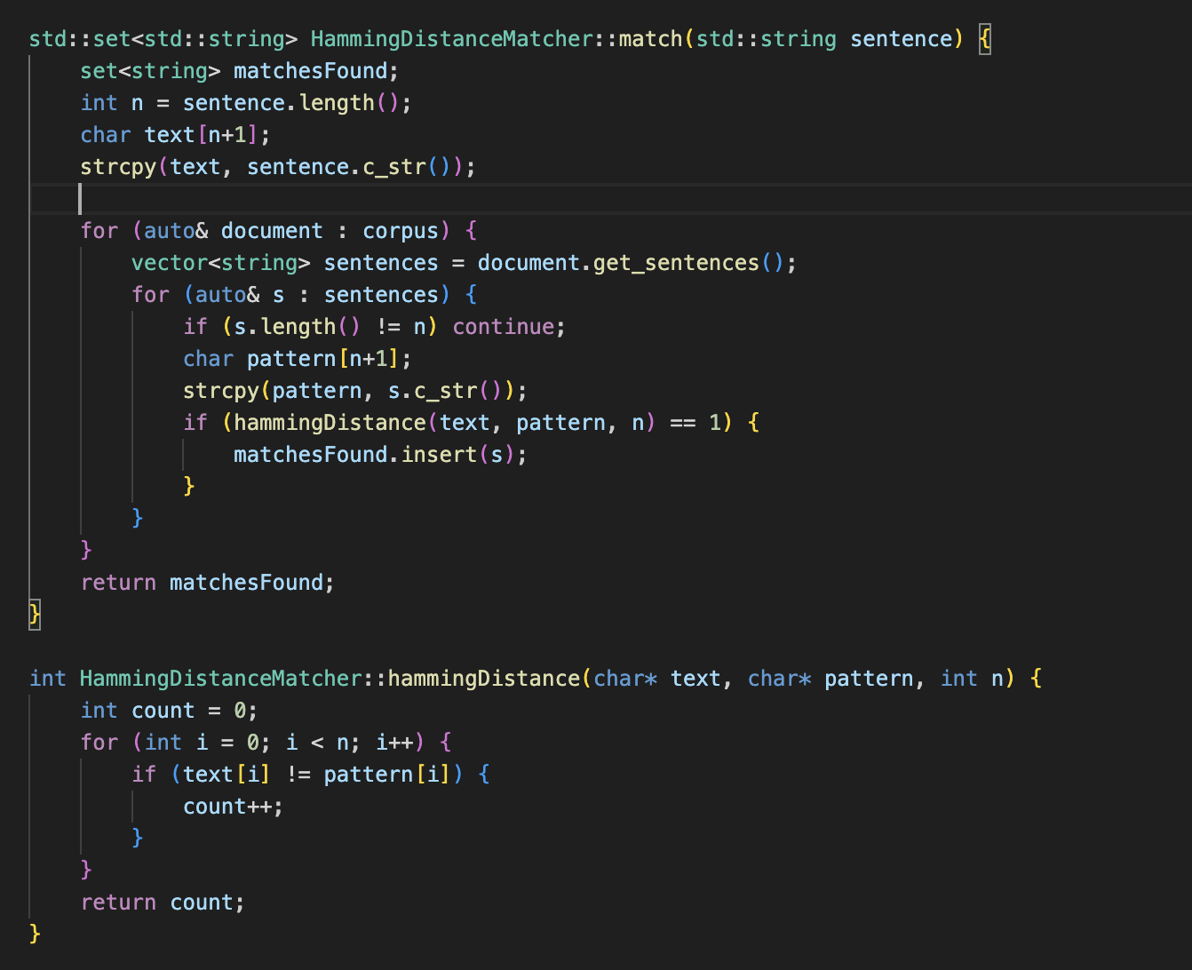
Brute force / hamming distance approach
Limitations
Not ideal as it does not “learn” from its mistakes
Does not consider a possible structure in the pattern
Does not have preprocessing, making it computationally expensive.

Slide 9
The Knuth-Morris-Pratt (KMP) algorithm
Theory
Preprocessing
calculates the value of the longest prefix suffix value (lps[] ). Where lps[0]=0 and lps[i] represents the length of the longest prefix suffix of the pattern substring pat[0…i], it iterates over the pattern string
If the character at that index of a pattern (pat[i]) matches the position pat[len], it means we have found a prefix that is also a suffix, and increments the index.
But if there is a mismatch (pat[len] and pat[i]), len should be adjusted to find the previous longest prefix suffix.
Utilizes preprocessing to avoid unnecessary comparisons
The preprocessing function tells us how far we should skip ahead if a mismatch happens, meaning it will skip over parts of the text where matches are near impossible.
When a mismatch occurs, the pattern is shifted by the appropriate amount given by the preprocessing function rather than increasing to the next index.

Slide 10
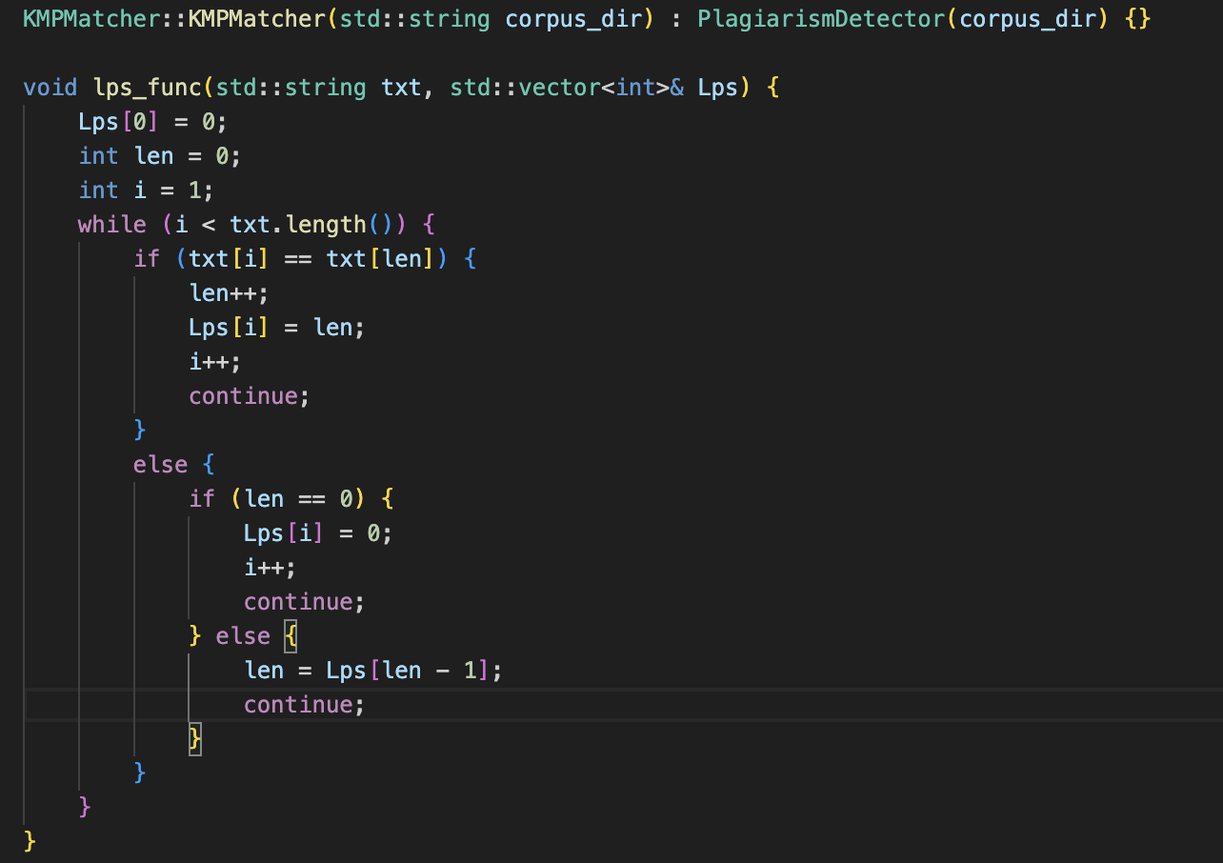
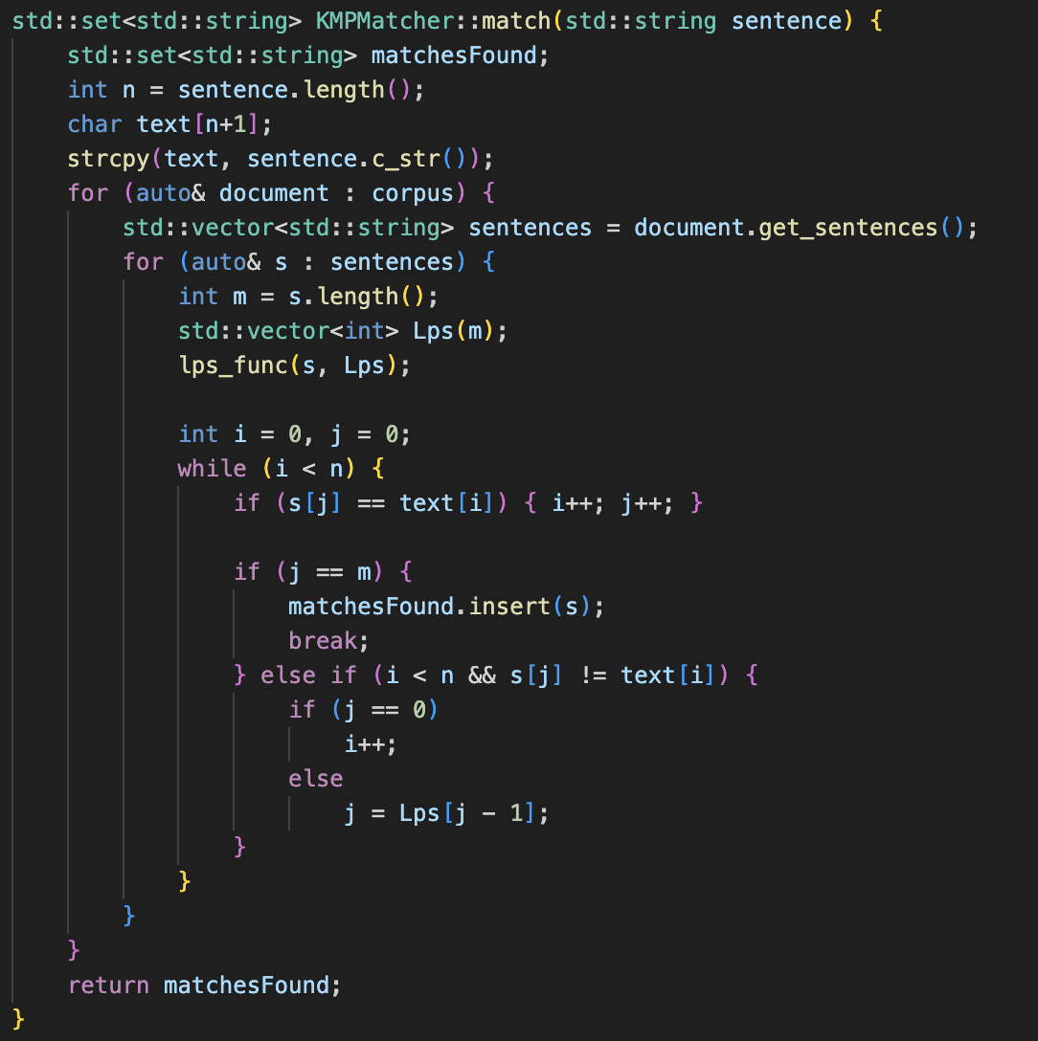
The Knuth-Morris-Pratt (KMP) algorithm
Evaluation
Time complexity is O(n +m)
More efficient and faster than brute force when there is a repeated structure.
But if it does not have any repetition, the brute force algorithm may even work more efficiently without the complexity of the KMP algorithm.

Slide 11
Boyer-Moore algorithm
Theory
Preprocessing
Boyer-Moore algorithm uses preprocessing function with bad character and good suffix rules.
Preprocessing can be time-consuming for some patterns with numerous repetitions or long suffix.
Additional space is required to store bad character and good suffix rules, increasing the space complexity.
Boyer-Moore algorithm uses preprocessing function and checks text from right to left.
It benefits from bad character and good suffix rules to minimize comparisons.
Time complexity is O(n+m), but can be O(nm) in worst-case scenario and O(m) in best-case scenario.

Slide 12
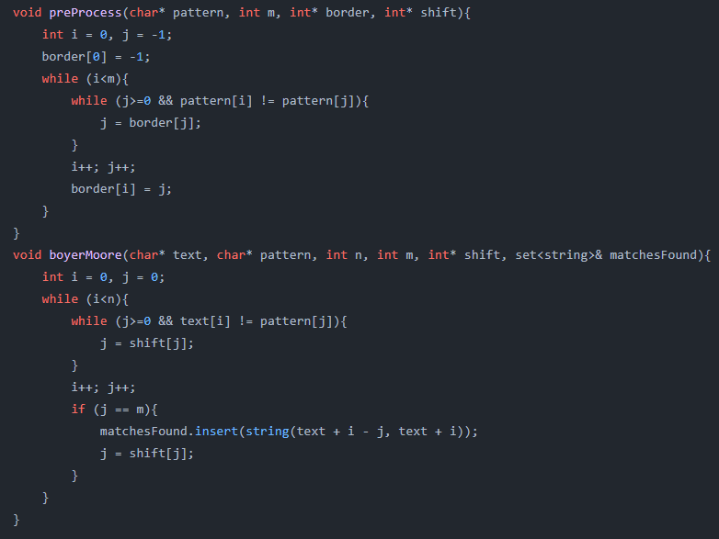
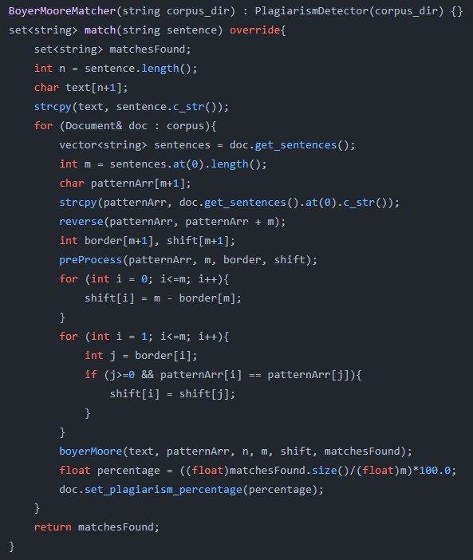
Boyer-Moore algorithm
Evaluation
Boyer-Moore is highly efficient with large alphabets and doesn't depend on auxiliary arrays.
It requires additional space to store bad character and good suffix rules, increasing space complexity.
Preprocessing can be time-consuming for some patterns, and it may perform a full comparison at each position in the worst-case scenario.

Slide 13
Rabin-Karp Algorithm
Theory
Pattern-matching process
The pattern matching process determines each "window's" hash value as it slides a "window" over the text string the same length as the pattern
then checks the current window's hash value to the pattern's hash value.
Comparing characters one by one confirms that the pattern matches if the values are equal. This is repeated until a match is made or it reaches the text string's end.
Similar to the naive approach but uses hashing.
And includes a preprocessing function
Which calculates the hash value of the pattern string and all possible substrings.
It uses the concept that if 2 strings are equal in hash value, the pattern is the same

Slide 14
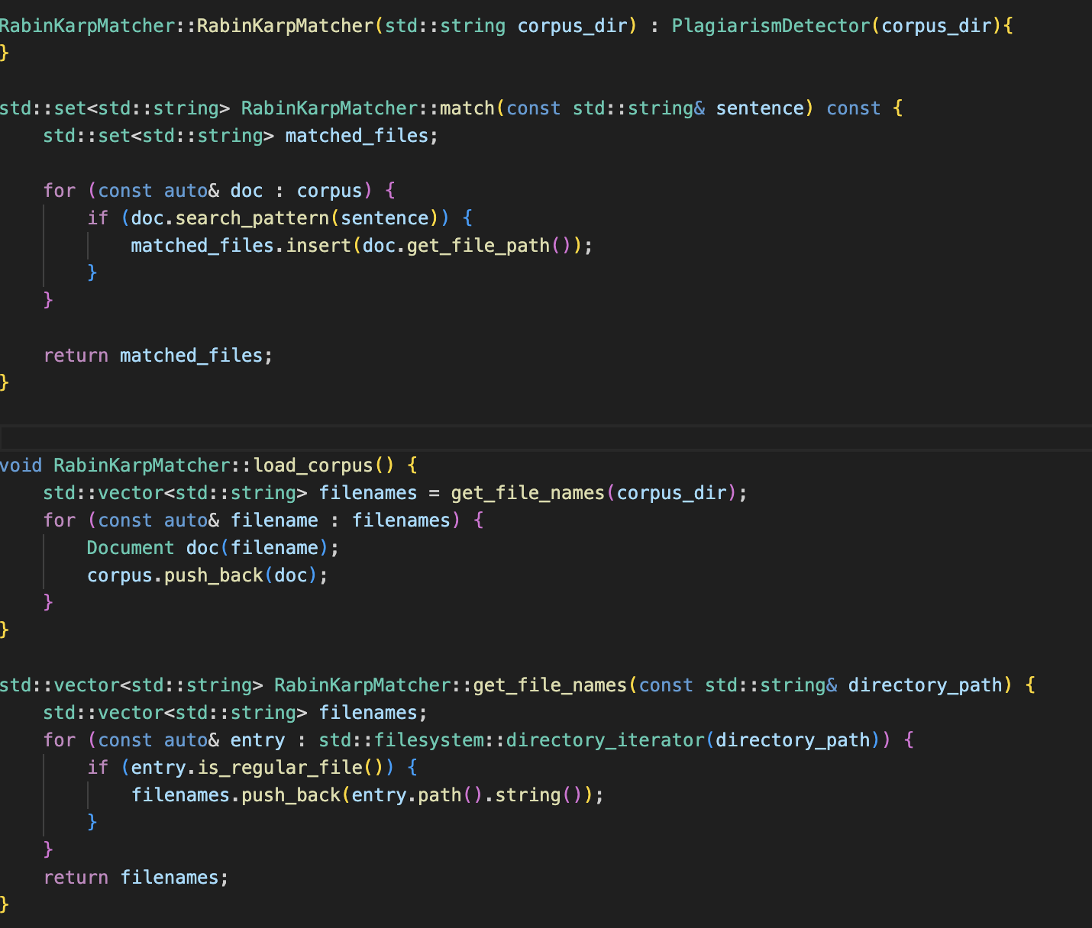
Rabin-Karp Algorithm
Evaluation
The time complexity of the Rabin-Karp approach is O((n-m+1)*m).
Overall, the KMP algorithm is the most efficient, with minimal drawbacks.
However, it is not efficient to be implemented with smaller patterns, as the preprogramming function might outweigh the benefits. So using the naive approach may be more appropriate in these circumstances.

Slide 15
04
Qt Application
The implementation of the algorithms using the user interface application Qt-Creator

Slide 16


Inspiration: Windows XP
Inspiration
https://api.time.com/wp-content/uploads/2014/04/winxppro.png
Option A
Our User Interface

Slide 17


Features On The Desktop
Search Button: Opens the Application which the
user is going to upload the documents
(An extra feature it has is that it can also minimize the application when pressed if the application is open)
Time and Date Display: This feature provides the user with the exact time and date
Desktop Loader Button: When clicked, this button reveals the desktop without closing the application.
(It cannot be clicked before the user opens the application)

Slide 18
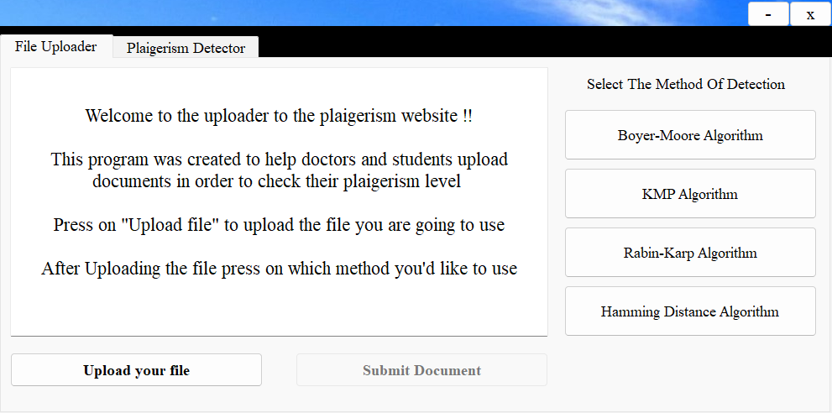
The Application

Slide 19
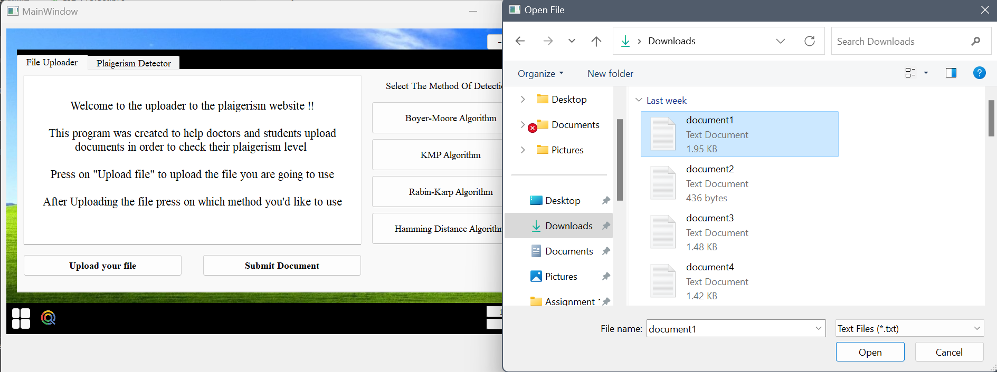
When Clicking Upload File:

Slide 20
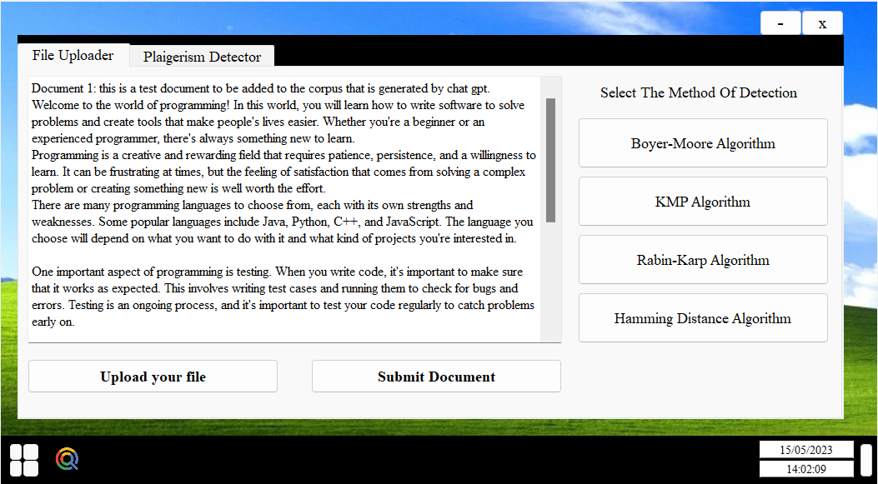
After Uploading:

Slide 21

Pressing Submit and Choosing Method:

Slide 22
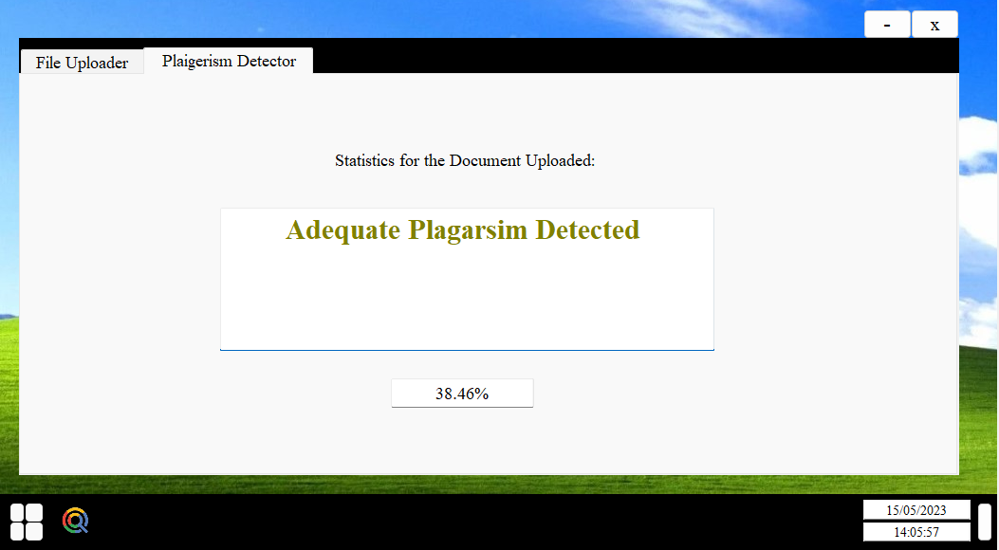
Switching Tabs for Results

Slide 23
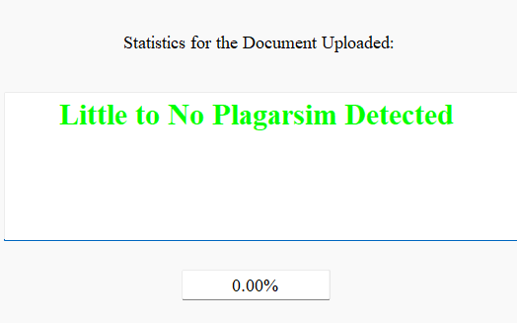
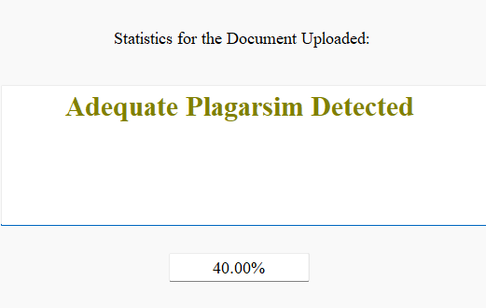
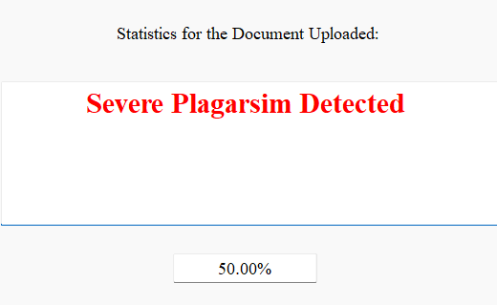
Different Outputs Depending on the Situation
User uploads a document with 0-10% Plagiarism
User uploads a document with 11-40% Plagiarism
User uploads a document with 50-100% Plagiarism

Slide 24
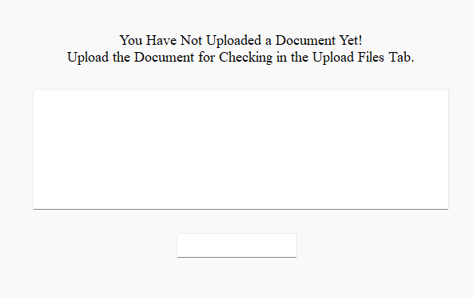
Different Outputs Depending on the Situation
User goes to Detector Tab without Uploading anything

Slide 25
Extra Unmentioned Features in the Application
Exit Button: Like a normal exit button it resets the application for the user again
Minimize Button: This feature lets the user view desktop without losing any progress made

Slide 26
Extra Features We Wanted to Add
A Highlighter Tool that Highlights the Plagiarised Texts to make the user familiar with the Plagiarised Texts.
A Tab that compares between the two texts (Highlights the texts in common).
A Text Box that provides a link to a Paraphrasing tool, like Quillbot, that helps the user paraphrase the document and edit it (Potentially inside the application we made).
Tab that lets the user edit the document and resubmit it to get it checked again.

Slide 27
05
Conclusion

